Slide 1
Pastor:
Paul W. Young
Youth Pastor:
Joel P. Young
“…to Him be the glory in the church and in Christ Jesus to all generations forever and ever. Amen.”
~ Ephesians 3:21 ~

Slide 2
Please send prayer requests to Shirley Spears via email, or in the Summers Prayer Partners Facebook group.
Therefore, confess your sins to one another, and pray for one another so that you may be healed. The effective prayer of a righteous man can accomplish much. ~ James 5:16

Slide 3
Summers Missionary Baptist Church
@SummersBaptist
www.summersbaptistchurch.org

Slide 4
Our Weekly Sermon Slides, Welcome Slides, and Bulletins are now available on our website.

Slide 5
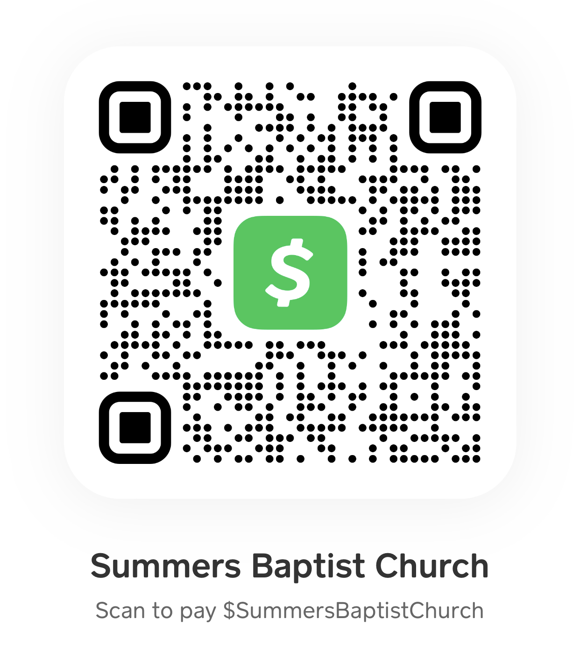
Online Giving
Scan the code here or in the bulletin to submit your tithes and offerings via the Cash App.

Slide 6
We now have a church app…
Download “Churchflare” and search for Summers Baptist Church

Slide 7
Today – Allie Parker
Apr 6th – Erin Odom
Apr 13th – Garland & Gentry Spinks
Apr 20th – Easter Sunday

Slide 8
We need help in our Nursery ministry! Please see Bro Joel.

Slide 9
Sunday Small Group Bible Studies
Grief Support – Last Sunday

Slide 10
THIS WEDESNDAY!!!
Meal at 5:30 ($1.00 per person or $5.00 for the family)
AWANA Clubs 6:15-7:30

Slide 11
Join us for Youth Group each Wednesday at 6:30pm

Slide 12
Join us for Wednesday evening adult Bible study at 6:30pm (in person or Facebook Live)

Slide 13
Saturday, 04/12/2023
Start at 9:00

Slide 14
Saturday, April 19th
Donuts/Juice at 9:00
Egg Hunt at 9:30

Slide 15
Easter Sunday Schedule
1st Service 8:00
Breakfast 9:00
Sunday School 10:00
2nd Service 11:00
Evening 6:00

Slide 16
Annual Youth Fundraiser
Sunday, April 27th
Bring a smile and your checkbook

Slide 17
TheMaster’sBuilders are on Facebook!!!

